Slide 1
STABILITY IN HIGH-POWERED SOUNDING ROCKETS
ROAR - Robot On A Rocket
Hannah Thoreson, ASU/NASA Space Grant
Mentor: Dr. James Villarreal

Slide 2

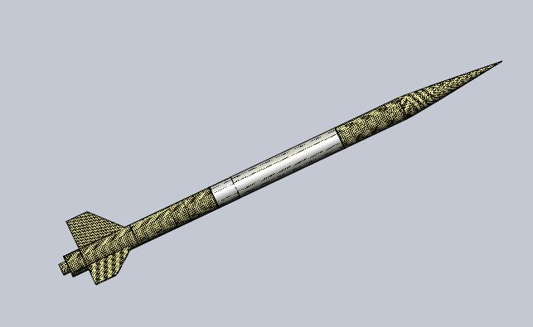
Payload Separation and Deployment
OBJECTIVES: Ensure the integrity of the payload during separation from the launch vehicle and deployment of the robotics component of the project. Bring payload in for landing, deployment, and recovery at a velocity that guarantees the safety of bystanders.

Slide 3
Specifications
Payload should be able to withstand the force of separation
17 ft/s landing velocity
Proper orientation of robotics payload upon ground landing

Slide 4
Optimization of Impulse Mitigation Plans
Spring-damper dashpot system
Matlab program to calculate and plot oscillations from impulse of parachute deployment
User inputs values for the mass of the combined payload and housing cabinet, the spring constant, and the damping constant

Slide 5


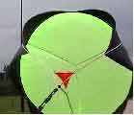
Design Outcomes, Pt. I
Use of a “slider” to slow the speed of parachute deployment

Slide 6
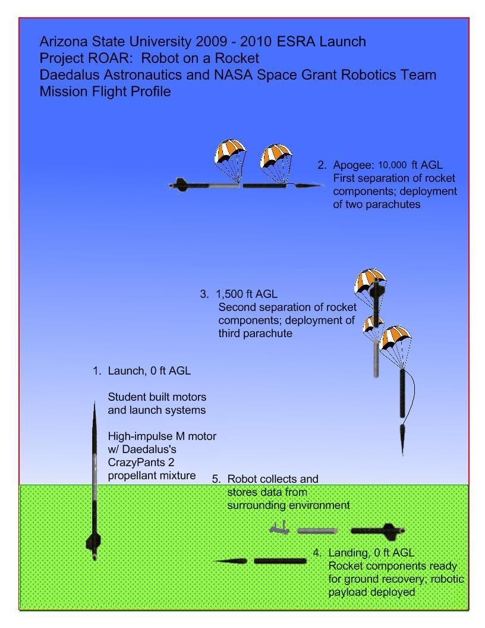
Design Outcomes, Pt. II
Five parachutes, sized to bring craft in at safe landing velocity of 17 fps
“No right side” robot to avoid issues with uncertain landing orientation

Slide 7
Regression Rate Analysis
New project begun in late March with graduate students
Will attempt to predict where combustion instabilities from pressure fluctuations inside the rocket will occur
Without prediction, there will never be resolution

Slide 8
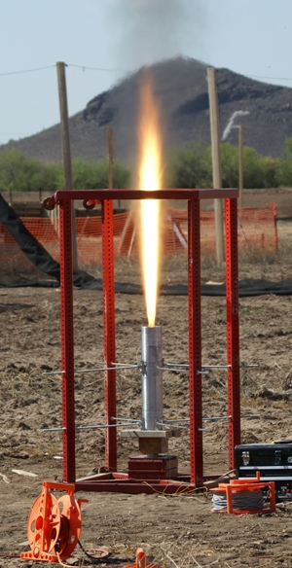
Experimental Set-Up
Pressure Transducer
Data Acquisition System
Matlab
Fourier Transform
Human Analysis
The paoad, in expanded form after leaving te rocket casing.

Slide 9
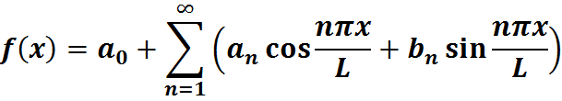
The Fourier Transform
fs = 960 % Sample frequency
[data fs] = csvread('data.csv'); % Reads in data from CSV file
t = linspace(0,length(data)/fs,length(data)); % Time
plot(t,data)
xlabel('Time (seconds)')
ylabel('Pressure Amplitude')
title('Time Domain Plot of Pressure')
y = fft(data); % FFT of the data
f_Nyquist = fs/2; % Nyquist frequency
[y_max index] = max(y); % Principle frequency
f = (0:t-1)*(fs/t); % Frequency range
plot(x,y)
xlabel('Frequency (Hz)')
ylabel('Pressure')
title('FFT Output')

Slide 10
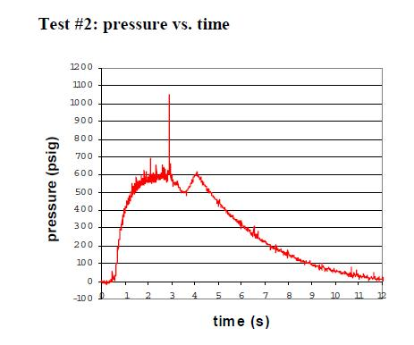
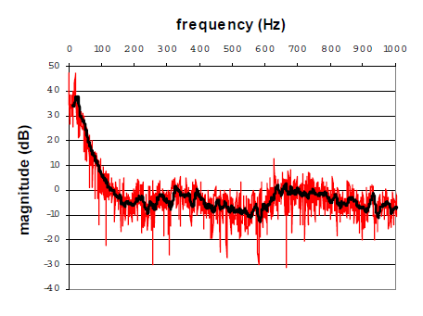
Expected Outputs

Slide 11
To be continued!

